Slide 1

Snapchat – UX Design Plan Dharu Piraba Muguntharaman dm5596

Slide 2

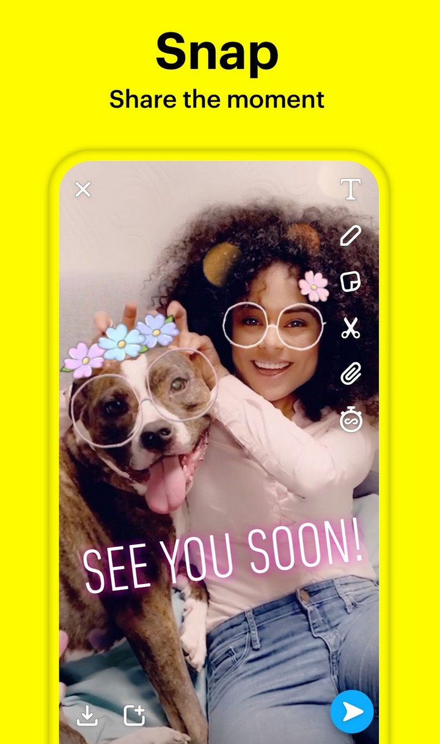
What is Snapchat??
American multimedia instant messaging app and service developed by Snap Inc.
Roughly 150 million people use Snapchat every day
Consume around 800 hours of video per second .

Slide 3
Affordances
Photo Sharing
Filters and Lenses
Users may quickly capture and exchange photographs and videos with friends
Add a range of filters, lenses, and augmented reality (AR) features to their images and videos
Instant Messaging
Memories
Communicate with friends in real-time chats and send text messages
Save and revisit previously sent snaps

Slide 4


Signifiers
Users can take snaps or videos by pressing the camera button.
The buttons for the filters, lenses, and stickers are found in the home screen.
Users can chat with friends using the chats icon on the menu
Memory button to save and revisit previously sent snaps

Slide 5

Persona Design
Leah Morgan – 19-year-old, college sophomore living in New York.
Interests
Plays guitar
Plays soccer
Baking
Online shopping
Partying
Pop music, movies, TV shows popular with teens.
Goals for Snapchat
Stay connected with friends and family.
Engage with brands/influencers relevant to her.
Wants to share fun moments with friends throughout the day.
Share casual content without worrying about it being "permanent".
Daily Life Highlights
Constantly takes photos and videos.
Keep up with all the latest social media trends.
Active on all social media platforms.

Slide 6
Customer Reviews
Pros :
Easiest to connect with friends anytime, anywhere.
Sending a picture through Snapchat is one of the fastest ways to send a photo.
Sending notifications of someone who is secretly safe videos or taking a screenshot without permission.
Cons:
There are a lot of options that are not very clear
Showing random stories of people, I don’t want to see
Overwhelmed by the layout and buttons

Slide 7
Constraints
Challenging layout
Too many features
No personalized discover section
Streak reminders
Privacy

Slide 8
Snapchat Prototype Design

Slide 9
Problem 1 – Home Screen
About the Feature:
The home screen has the camera on by default to send snaps
lots of features and filters options on the side
The menu at the bottom has options to change between sending snaps and chat screens.
Issue:
Crowded design
Too many buttons without meaning
Difficult to navigate between options
Solution:
Remove unnecessary buttons
make a simple design

Slide 10
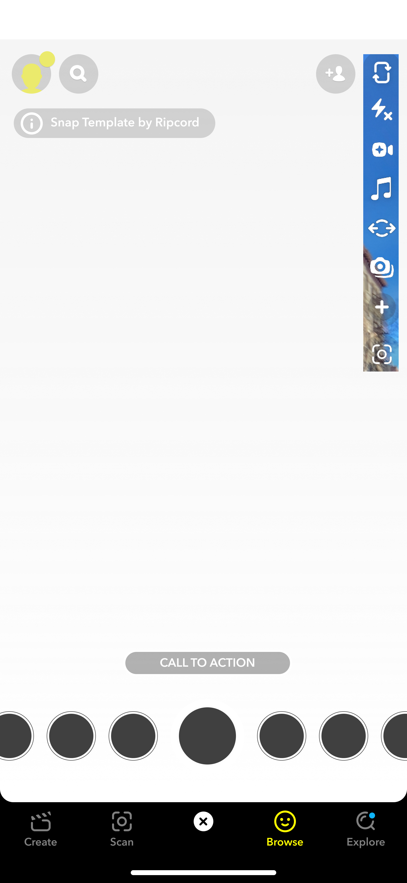
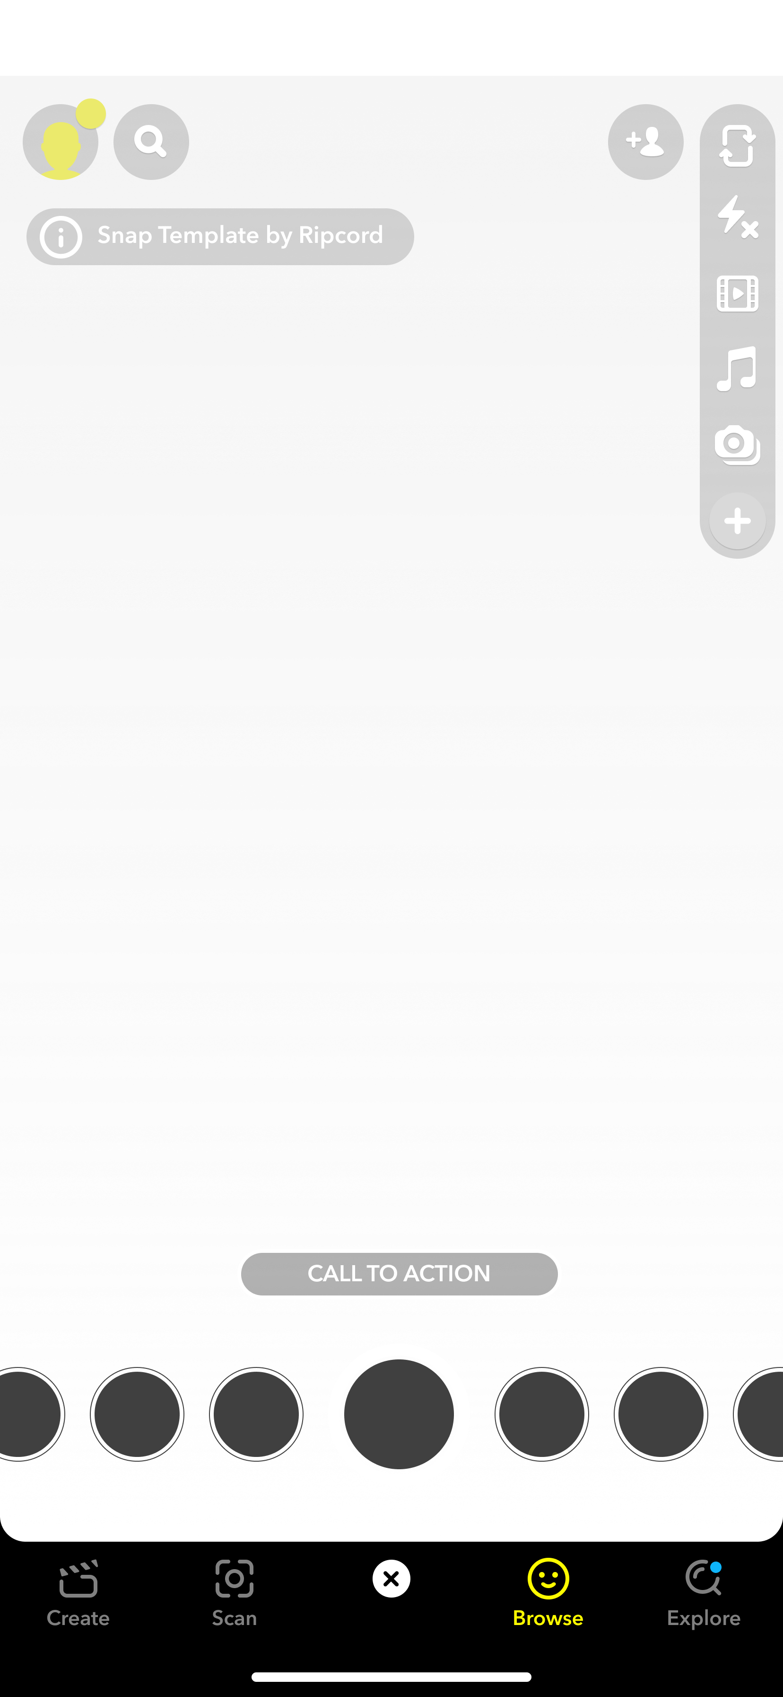
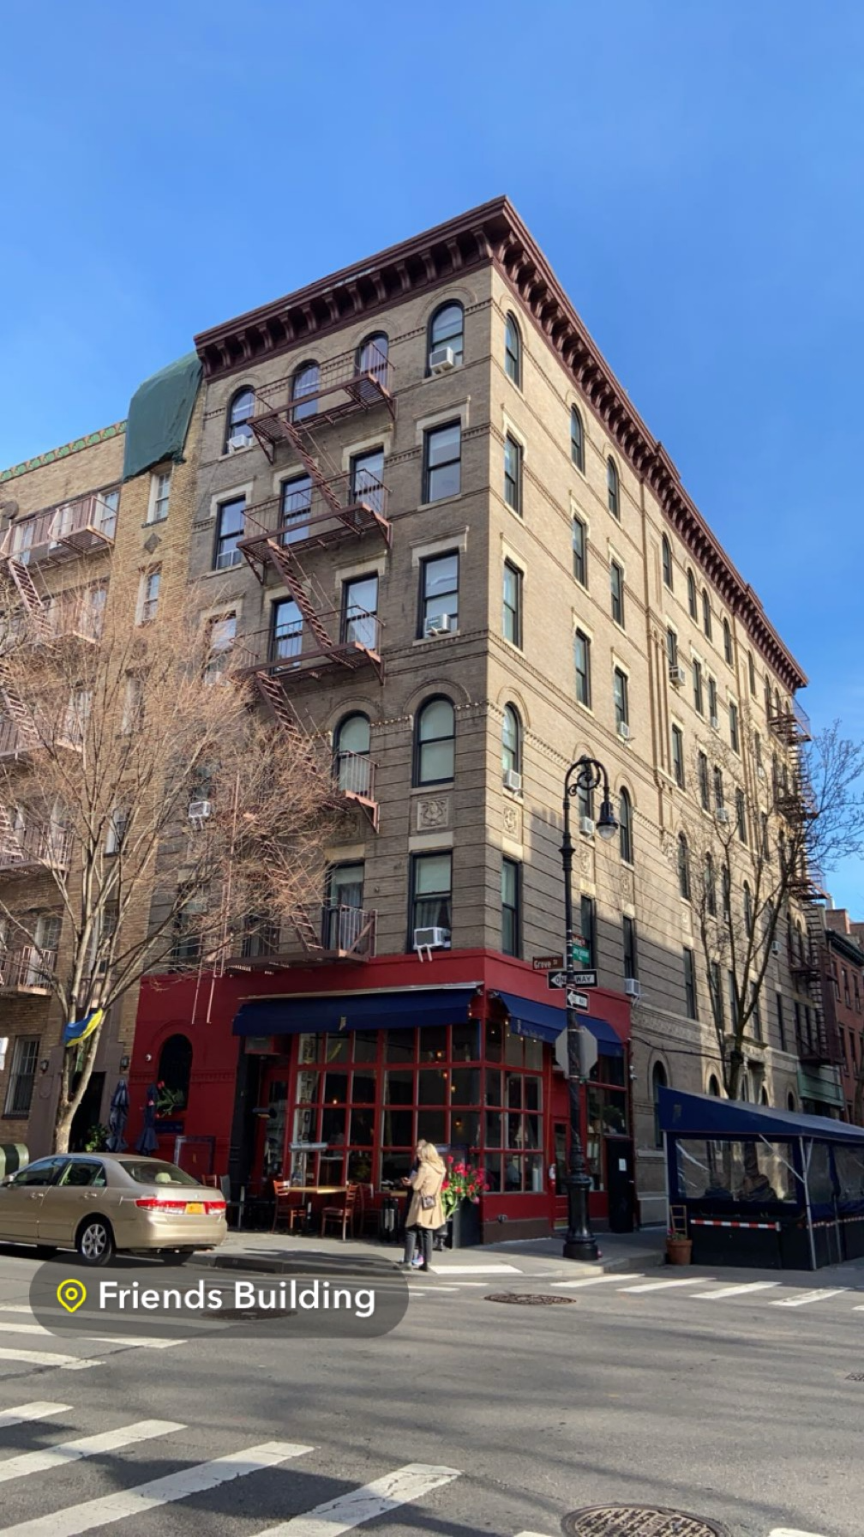

Actual design
Proposed design

Slide 11
Problem 2 – Discover Page
About the Feature:
The discover page allows to view stories
Displays a list of stories from friends and others
Allows to add new friends
Search for anything
Issue:
Endless random feed with advertisements
Confusing search option
Displays stories people not interested in
Solution:
Create a personalized discover page
Include sort filters for categories.
Enable the list of mutual friends
Remove ads when watching friend’s stories

Slide 12
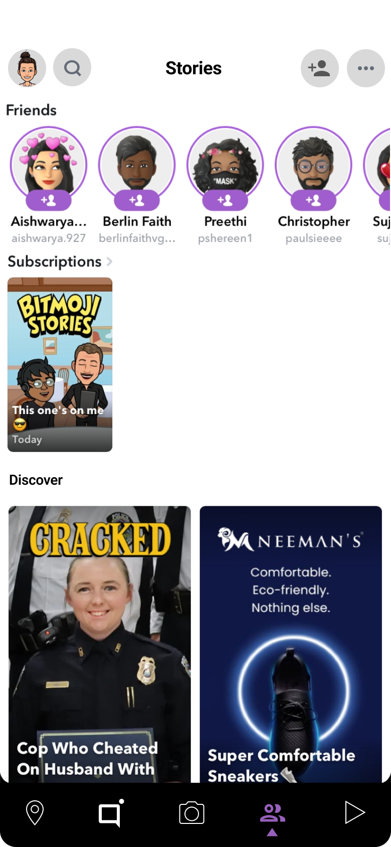
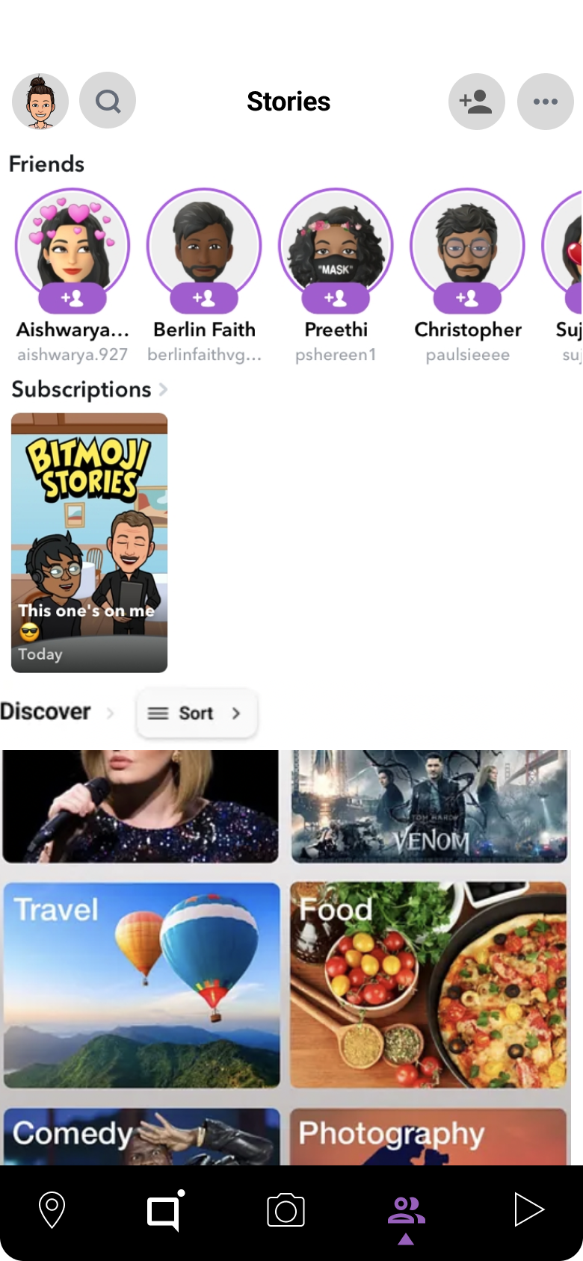
Actual design
Proposed design

Slide 13
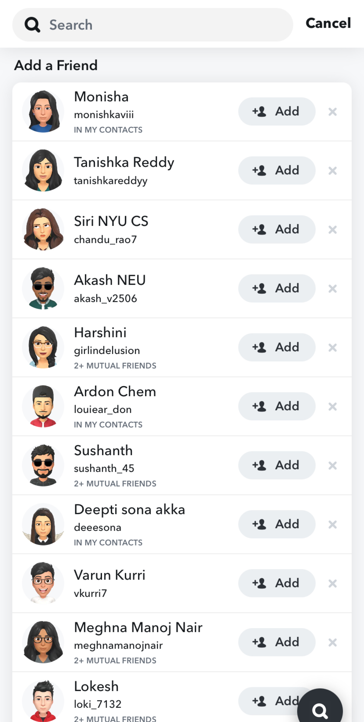
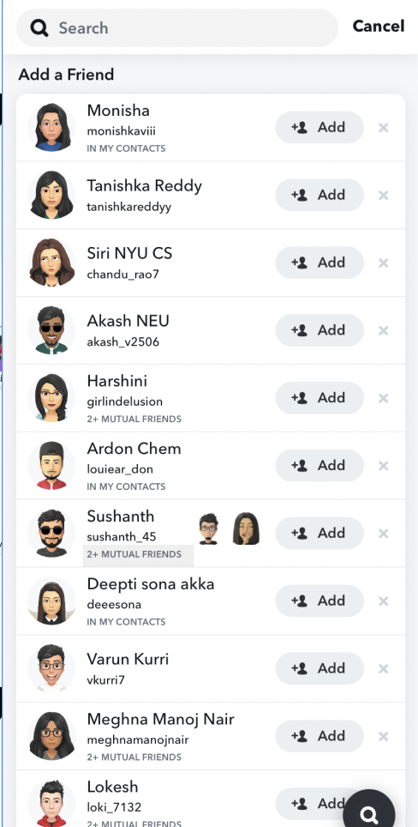
Actual design
Proposed design

Slide 14
Problem 3 – Maintaining Streaks
About the Feature:
Streaks are how many days when both people send snaps.
The validity of a streak is 24 hours
Streaks are counted and if not on time they are lost completely
Timer is displayed if streak is going to end
Issue:
People forget to send snap on time to maintain the streak
Timer is displayed only when you login to the app
People need to send messages in other apps to notify about this
Solution:
Create a notification when streak is expiring
Have option to set notifications based on friends list
Make it a little personal

Slide 15
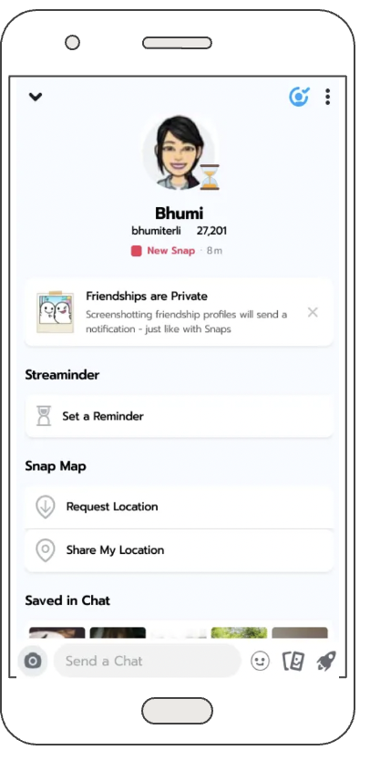
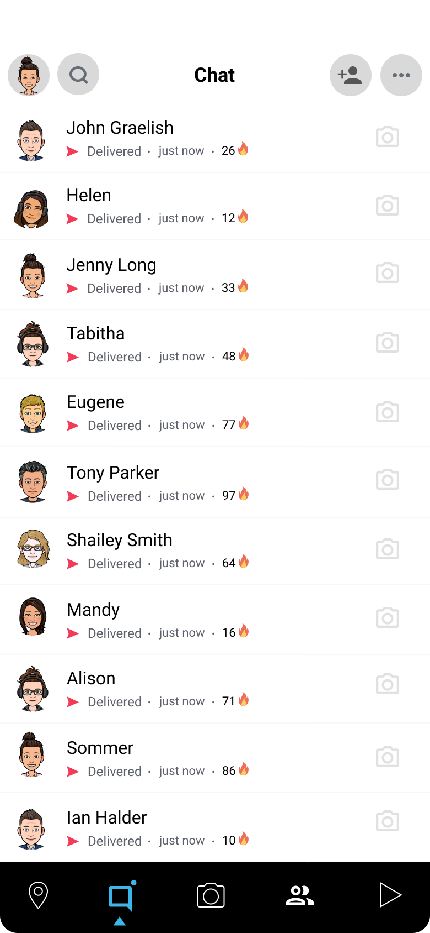
Actual design
Setting reminder

Slide 16
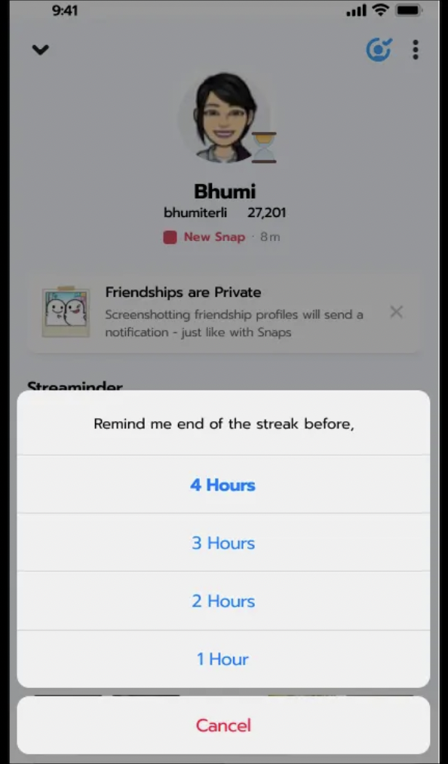
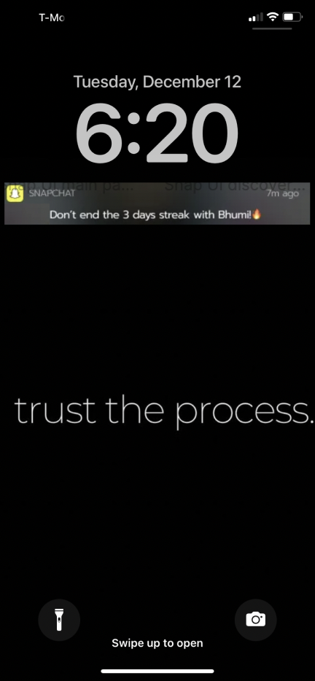
Setting time for reminder
Personalized Notification

Slide 17
Problem 4 – Snap Map
About the Feature:
Snap Map allows to view the location of your friends.
It also displays the most trending locations near you
Shows a list of places around the location
Issue:
The map search is too complicated
Displays random places on search based on trends
Places are not listed on any order
Solution:
Create a display of places in sorted order
Show places visited by my friends first to make it more personalized

Slide 18
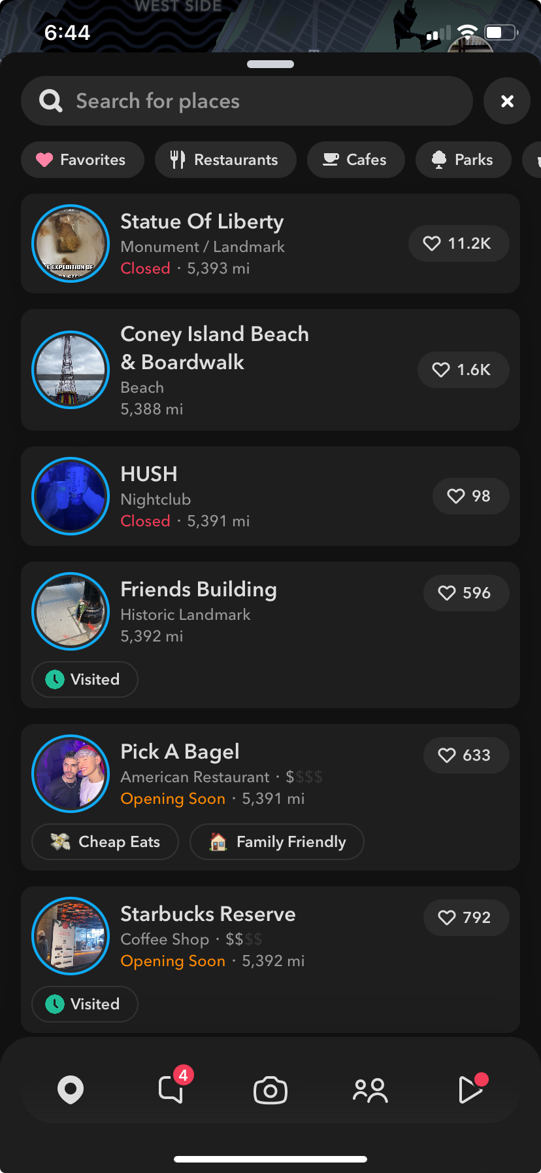

Search for places
Coney Island park
3.2 miles
Starbucks
4 miles
Brooklyn bagels
5.4 miles
Visited by 4+ friends
Friends building
7.5 miles
Central park
13.2 miles
Statue of Liberty
18 miles
Options
Actual design
Proposed design

Slide 19
Problem 5 – Data and Battery
About :
Snapchat filters can be used only when there’s an internet connection
Video and map features always on leads to more battery usage
Issue:
Some filters takes too much of data
Limited offline filters
Drains battery faster than normal
Solution:
Develop more offline filters
Optimize the app to reduce battery usage

Slide 20
Problem 6 – Privacy
About :
Photos and videos – viewed only once by default
No storing of chats
Complicated privacy policies
Issue:
Inappropriate photos or videos could be sent
No proper control over discover section
Difficulty understanding privacy policies leading to possible data breaches
Solution:
Develop a strict protocol to restrict certain age groups from viewing inappropriate content
Simpler policies and more control for users
Parental control for teenagers

Slide 21
Conclusion
Snapchat demonstrates human-centered design by meeting the needs of its users, which are primarily young people who want to be creative, authentic, and have fun.
Snapchat uses an iterative design process to ensure that the product is always improving and meeting the needs of its users. In general,
Snapchat is a well-designed platform that offers numerous examples of human-centered design.
However, there are a few areas where Snapchat's platform could be made more accessible, users could have more control, and it could be more transparent.

Slide 22
References
https://medium.com/@busiwalther/case-study-redesigning-snapchat-pt-2-a47ce4d8fb35
https://medium.com/@amrmelharony/the-rise-and-fall-of-snapchat-a-rollercoaster-journey-in-the-social-media-world-edf080446de9
https://medium.muz.li/improving-the-snapchat-experience-a-ux-case-study-ceaa54a21d88

Slide 23
Thank you

